Slide 1


Lesson 6
Leading the Change
SAFe® Course - Attending this course gives students access to the SAFe® Agilist exam and related preparation materials.

Slide 2

Why Lean-Agile Leadership?
An organization’s managers, executives, and other leaders are responsible for the adoption, success, and ongoing improvement of Lean-Agile development and the competencies that lead to Business Agility. Only they have the authority to change and continuously improve the systems that govern how work is performed.

Slide 3
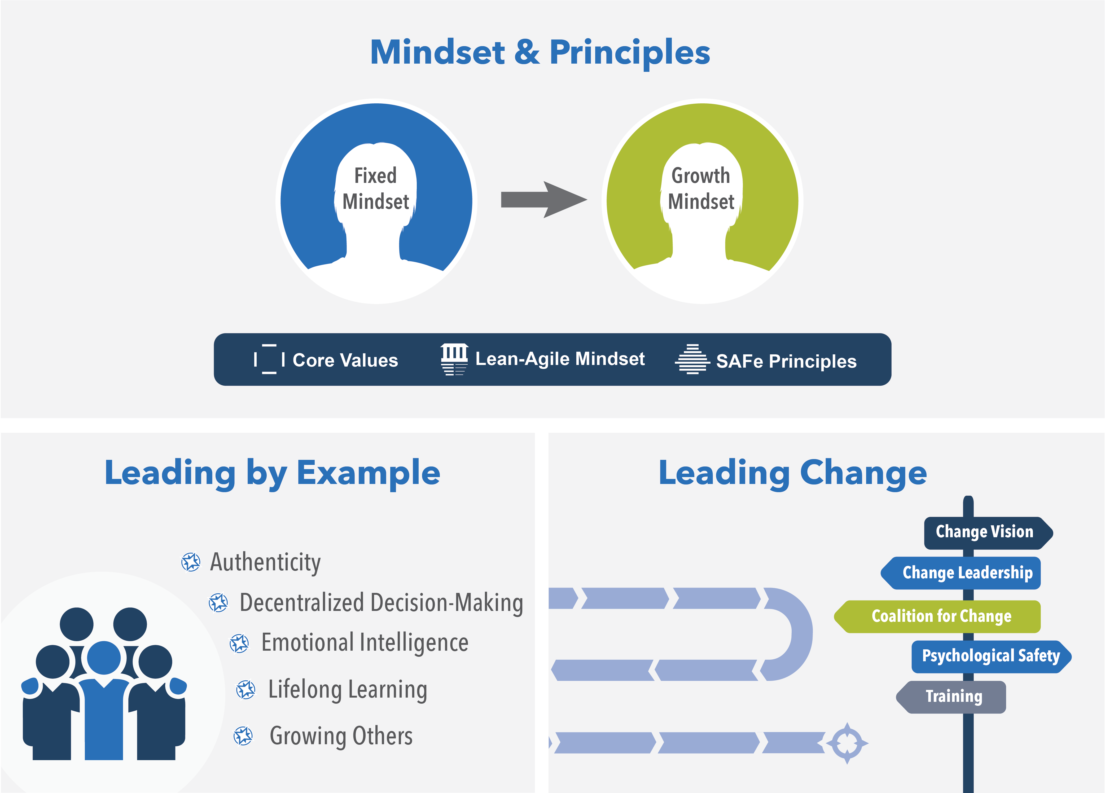
Lesson Topics
6.1 Leading by example
6.2 Leading the change
3
Notes:
Trainer Guidance:
Review the lesson 6 topics with the class. This lesson will focus on the Leading by Example and Leading Change dimensions of the Lean-Agile Leadership competency.

Slide 4
Learning objectives
At the end of this lesson you should be able to:
Explain the behaviors necessary to lead by example
Discuss techniques for leading successful change
Recognize the steps in the SAFe Implementation Roadmap
Notes:
Trainer Guidance: Review each learning objective for Lesson 6 with the class.

Slide 5
6.1 Leading by example

Slide 6
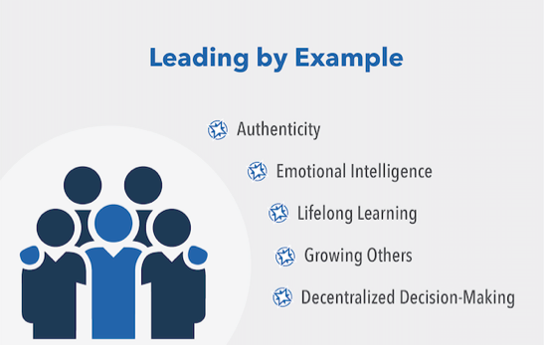
Leading by example
Setting an example is not the main means of influencing others, it is the only means. —Albert Einstein
Authenticity requires leaders to model desired professional and ethical behaviors
Emotional intelligence describes how leaders identify and manage their emotions and those of others through self-awareness, self-regulation, motivation, empathy, and social skills
Lifelong learning depicts how leaders engage in an ongoing, voluntary, and self-motivated pursuit of knowledge and growth, and they encourage and support the same in others
Growing others encourages leaders to provide the personal, professional, and technical guidance and resources each employee needs to assume increasing levels of responsibility
Decentralized decision-making moves the authority for decisions to where the information is
Notes:
Trainer Guidance:
What, then, are the behaviors that leaders should embrace to set the right example and build a generative culture? While the potential list of attributes could be quite long, the aspects below form a solid foundation for this dimension of leadership.
Authenticity requires leaders to model desired professional and ethical behaviors. Acting with honesty, integrity, and transparency, leaders are true to themselves and their beliefs.
Emotional intelligence describes how leaders identify and manage their emotions and those of others through self-awareness, self-regulation, motivation, empathy, and social skills.
Lifelong learning depicts how leaders engage in an ongoing, voluntary, and self-motivated pursuit of knowledge and growth, and they encourage and support the same in others.
Growing others encourages leaders to provide the personal, professional, and technical guidance and resources each employee needs to assume increasing levels of responsibility and decision-making.
Decentralized decision-making moves the authority for decisions to where the information is; prepares teams to make decentralized decisions by investing in their technical competence; and by providing organizational clarity with decision guardrails.

Slide 7
Leaders provide the organization with patterns of expected behaviors
Pathological Culture Power-oriented | Bureaucratic Culture Rule-oriented | Generative Culture Performance-oriented
Low cooperation | Modest cooperation | High cooperation
Messengers blamed | Messengers neglected | Messengers trained
Responsibilities shirked | Narrow responsibilities | Responsibilities shared
Collaboration discouraged | Collaboration tolerated | Collaboration encouraged
Failure leads to scapegoating | Failure leads to justice | Failure leads to improvement
Innovation crushed | Innovation leads to problems | Innovation implemented
Notes:
Trainer Guidance:
Leaders gain earned authority by modeling the desired behaviors for others to follow, inspiring them to incorporate the leader’s example into their own personal development journey.
Through their words and actions, leaders provide the organization with patterns of expected behaviors. The aggregation of those patterns determines the organization’s culture, whether good or bad. The most important and effective technique for driving the cultural change needed to transform into a Lean enterprise is for leaders to internalize and model the behaviors and mindsets of business agility so that others can learn and grow by example.
Author Simon Sinek underscores the importance of leading by example in his book Leaders Eat Last with the following:
The leaders of companies set the tone and direction for the people. Hypocrites, liars, and self-interested leaders create cultures filled with hypocrites, liars, and self-interested employees. The leaders of companies who tell the truth, in contrast, will create a culture of people who tell the truth. It is not rocket science. We follow the leader.
By modeling the right behaviors, leaders can transform organizational cultures from the pathological (negative, power-oriented) and bureaucratic (negative, rule-oriented) patterns of the past to the generative (positive, performance-oriented) culture that is required for the Lean-Agile mindset to flourish. (The image on the slide provides a comparison of the attributes of Westrum’s organizational culture model). These same behaviors also build earned authority—power gained through trust, respect, expertise, or action—which engenders greater engagement and commitment to organizational aims than positional authority. Such leaders inspire others to follow their direction and to incorporate the leader’s example into their own personal development journey.
Additional Resources: https://www.scaledagileframework.com/lean-agile-leadership/

Slide 8
6.2 Leading the change

Slide 9

Keys to leading successful change
Establish a sense of urgency
Create a powerful guiding coalition
Develop the vision and strategy
Communicate the vision
Empower employees for broad-based action
Generate short-term wins
Consolidate gains and produce more wins
Anchor new approaches in the culture
Notes:
Trainer Guidance:
One of our best thought leaders is Kotter. Here are some positive ideas from him that leadership can implement. These eight ideas are the responsibility of executive and senior management.
Key Message:
Ask: "Why is #8 last on the list?”
Answer: Because #8 can’t happen until the reward system is changed. It’s the result. As a worker, you feel better working when you feel your voice is heard and when you start to see the results. Culture doesn’t change until this happens.
It’s like Drucker said, “If you want people to be motivated, tell them their work is important” In this context, we need to think about the issues we want to address.

Slide 10
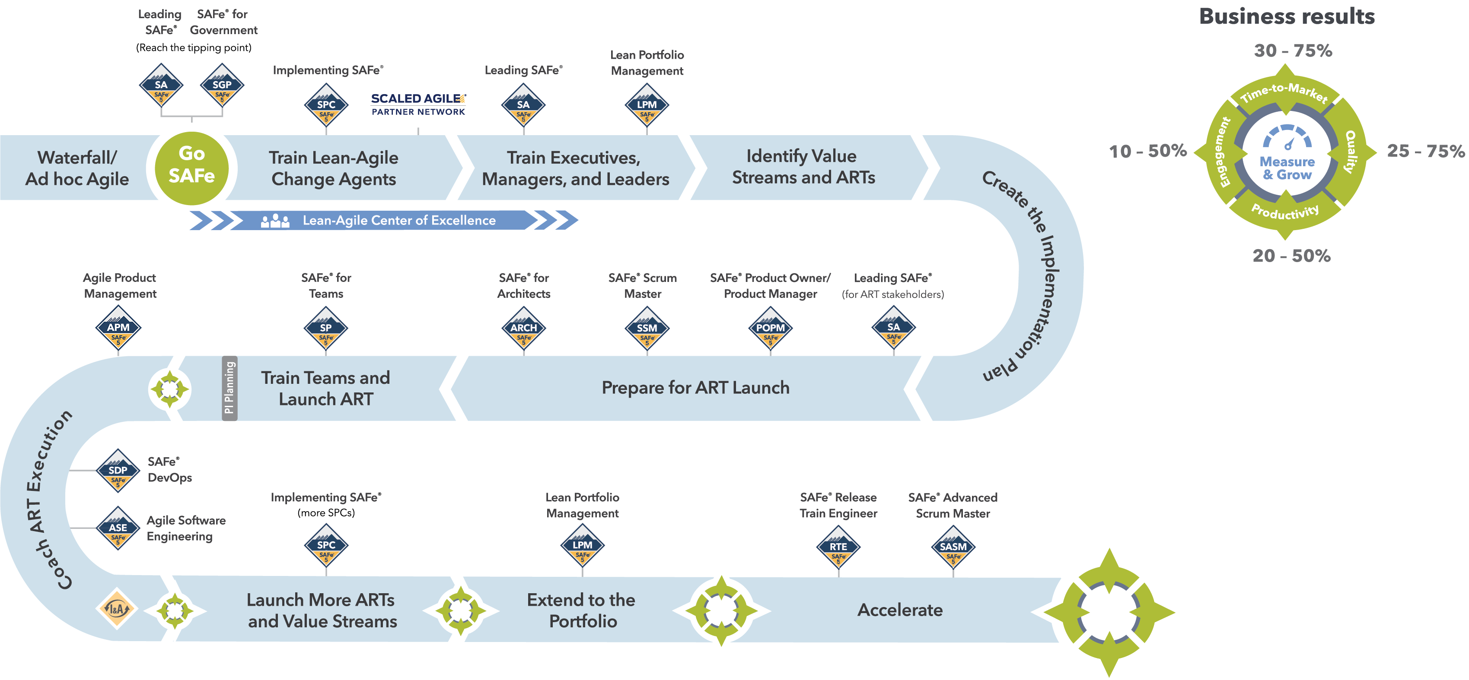
SAFe® Implementation Roadmap
Notes:
Trainer Guidance:
Achieving business agility and the benefits of Lean-Agile development at scale is not a trivial effort, so SAFe is not a trivial framework. Before realizing SAFe’s rewards, organizations must embrace a Lean-Agile Mindset as well as understand and apply Lean-Agile principles. They must identify Value Streams and Agile Release Trains (ARTs), implement a Lean-Agile portfolio, build quality in, and establish the mechanisms for continuous value delivery and DevOps. And, of course, the culture must evolve as well.
Based on proven organizational change management strategies, the SAFe Implementation Roadmap graphic and article series describes the steps or “critical moves” an enterprise can take to implement SAFe in an orderly, reliable, and successful fashion.

Slide 11

Train everyone.
Launch trains.
Notes:
Trainer Guidance:
Success can never be guaranteed, but to accelerate the changes two things are critical:
Train everyone. Make sure everyone, from teams to leaders, are trained in the new way of working.
Launch trains. Until we start, we will not learn how to improve.

Slide 12



Action Plan: Leading the change
Prepare
Share
5
3
Step 1: Identify three action items you can do in the next month to start leading the SAFe transformation.
Step 2: Share your ideas with your group.
Step 3: Discuss outcomes you hope to achieve with your Action Plan
Notes:
Trainer Guidance:
To summarize all new knowledge and create actionable items as take-a-ways.

Slide 13
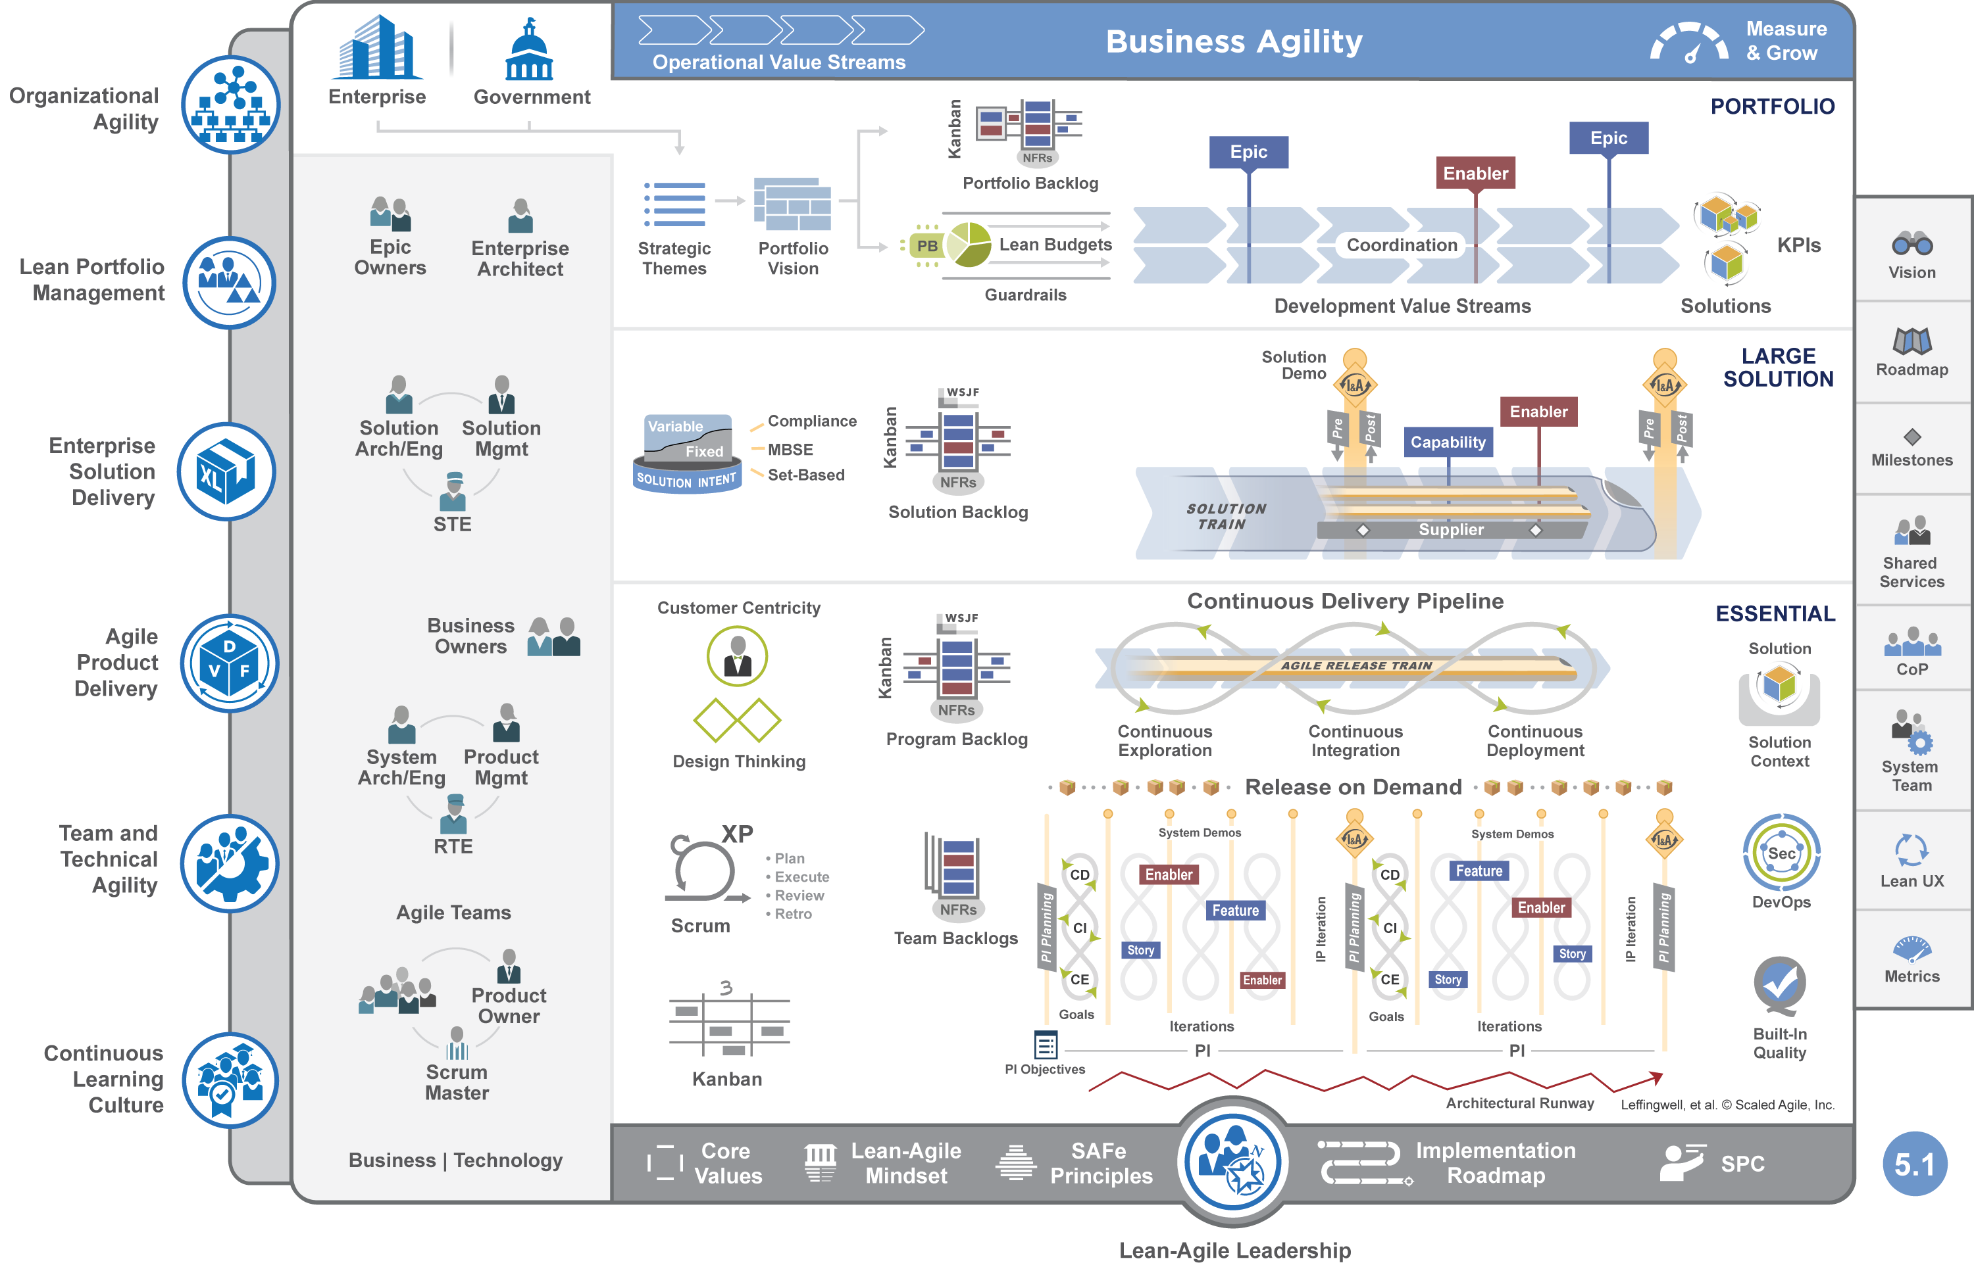

Lesson review
In this lesson you:
Explored the behaviors necessary to lead by example
Discussed techniques for leading successful change
Reviewed the steps in the SAFe Implementation Roadmap
Scaled Agile Framework Readings:
Lean-Agile Leadership, Implementation Roadmap
Notes:
Trainer Guidance: You may recommend the following articles to the learners, which are also listed in their workbooks: Lean-Agile Leadership, Implementation Roadmap

